Slide 1
Community Practice
Asset Management

Slide 2
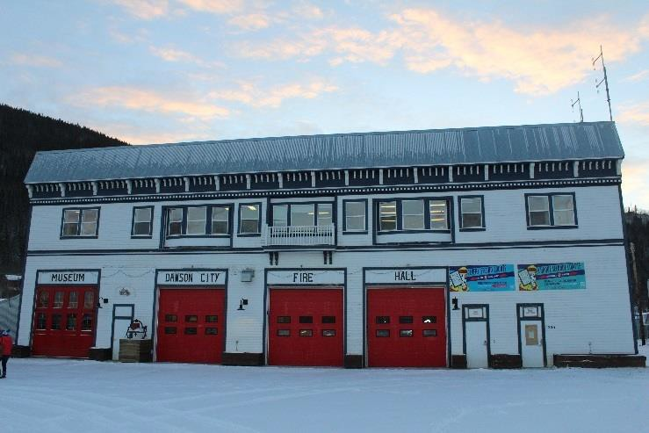
Dawson City Hall / Fire Hall
The City Hall / Fire Hall building is a two-story building constructed in 1988 and relocated to its current location in 2000. The relocation included a new concrete slab foundation, new superstructure framing, and other structural retrofits. The building mechanical systems were also updated in 2000 as part of the building retrofit.

Slide 3
Current Replacement Value
Asset ID | STR00011
Address | 1336 Front Street
Construction Date | 1988
Conditioned Floor Area | 1114.7 m2
Number of Floors | 2
Building Use | Main Floor: City Fire Department and Museum Second Floor: City Administration and Council Chambers
Hours of Operation | 9:00 – 17:00 Monday to Friday, plus emergency year-round
Occupancy | Unknown
General Construction Type | Concrete footing, Wood and steel frame
Current Replacement Value | $4,326,000

Slide 4
Asset Condition Assessment
Conducted by a third party consultant
Looks at all facility systems:
Siteworks
Exterior
Interior
Services (lighting/plumbing/mechanical)
Structure
Condition of each system is ranked 1-5 (very good to very poor)
Overall condition rating can be used to establish maintenance and replacement priority

Slide 5
Improvement Projects | Estimated Cost ($CAD) | ICC / SEB*
Condition Related Improvements
C.1 Landscape maintenance (weedkilling) and minor concrete repairs | $3,000
C.2 Repair exterior light fixture and/or bulb | $250
C.3 Replace exterior fuel tank and provide containment to conform to the current standards | $15,000
C.4 Re-paint exterior window frames as needed | $5,000
C.5 Re-paint exterior doors and repair wood on frames as needed and replace door (main level door to City Hall admin area) | $40,000 | SEB
C.6 Install soffit panel on underside of roof | $40,000?
C.7 Repair interior wall finishing cracks and water damage, general interior refurbishment and painting. See also # E3 below. | $15,000
C.8 General refurbishment of floors and coverings | $15,000
C.9 Repair door to billiards room | $500
C.10 Replace wash bay sink fixtures | $500
C.11 Replace elevator | $50,000
C.12 Monitor cracking and conduct structural investigation | $20,000
C.13 Inspect vapour barrier and insulation above Council Chamber to confirm cause of water damage and repair as needed. If roof integrity is compromised, then repair may be more significant. | $2,000 | SEB

Slide 6
Improvement Projects | Estimated Cost ($CAD) | ICC / SEB*
Energy Related Opportunities
E.1 Fix seal on air handling unit cabinet to improve efficiency of unit. | < $500
E.2 Ensure exhaust fan in the data server room is operational and sized properly to match the intake air from the door grill. May require new exhaust fan. | $2,000
E.3 Review heat balance through hydronic terminal units and update heating control systems to timer or motion-controlled system in line with building occupancy. Install new ventilation controls. | $15,000
E.4 Upgrade lighting through installation of LED bulbs, motion sensors and/or timers. Also maintain good behavioural practices such as procedure for switching off lights at end of day. Potentially upgrade controls in conjunction with heating controls. | $20,000 - $30,000
E.5 Review heating system opportunities prior to upgrading the boilers to maximise energy efficiency from currently available technologies. | $2,000 + boiler replacement
E.6 Review and replace door seals as needed. | $3,000 | ICC C.5

Slide 7
Why?
Include condition related improvements in financial planning
Identify short term maintenance goals and long-term replacement or improvement needs
Inform future funding applications or requests (ie. LED lighting)
Amortize large costs over time, and be prepared
Avoid increasing maintenance costs due to neglect

